Slide 1


INCENTIVIZING DIGITAL PAYMENTS
Lucky Grahak Yojana
&
Digi-धन Vyapar Yojana

Slide 2
  Current Scenario
Only 5% of PCE in India is Digital
1 Billion+ Mobile Connections
Low Taxation Base
371+ Million Smartphones
Large Informal Economy
25 Crore+ Jan Dhan Accounts Opened

Slide 3
  Drive Against Corruption and Black Money
25 crore Jan Dhan Accounts
Statutory Status to Aadhar
Introduction of RuPay Cards
Income Declaration Scheme
Demonetization of High Value Notes

Slide 4
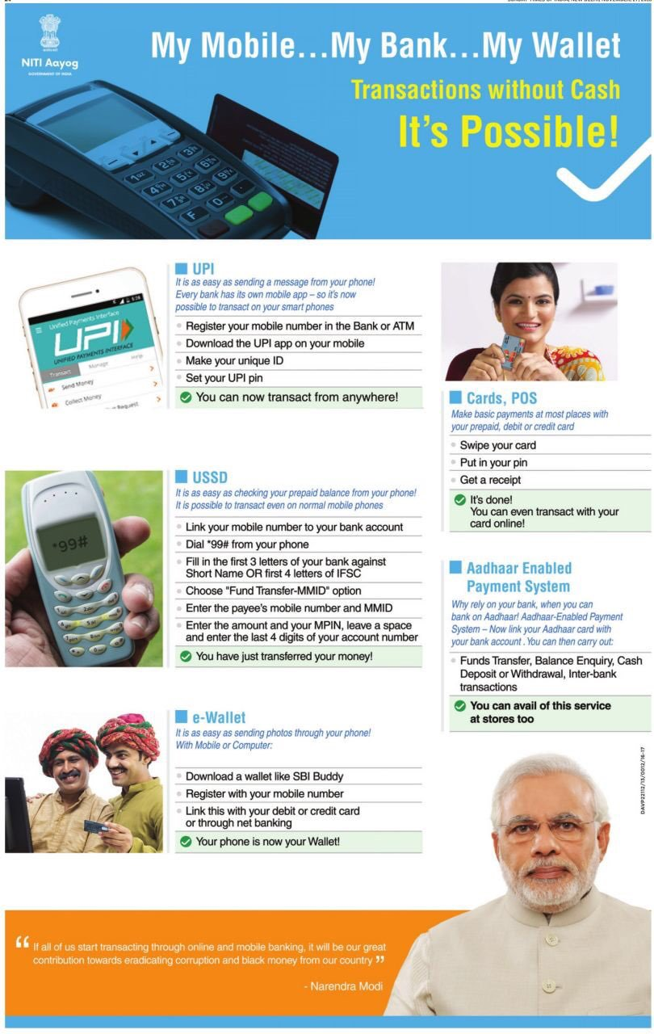
  Incentives to Promote Digital Payment
1 lakh Villages to be provided with 2 PoS machines
Regional Rural Banks & Cooperative Banks to issue 4.32 crore “Rupay Kisan Cards”
10% discounts at fuel purchase, highway tolls, rail tickets and insurance premiums
No service tax on all digital transaction upto Rs. 2000
PSBs advised to reduce PoS rentals to Rs. 100 per month
Free accident insurance cover of up to Rs. 10 lakh for online rail tickets
No transaction fees for payments made through digital means by Central Government Departments and PSUs

Slide 5
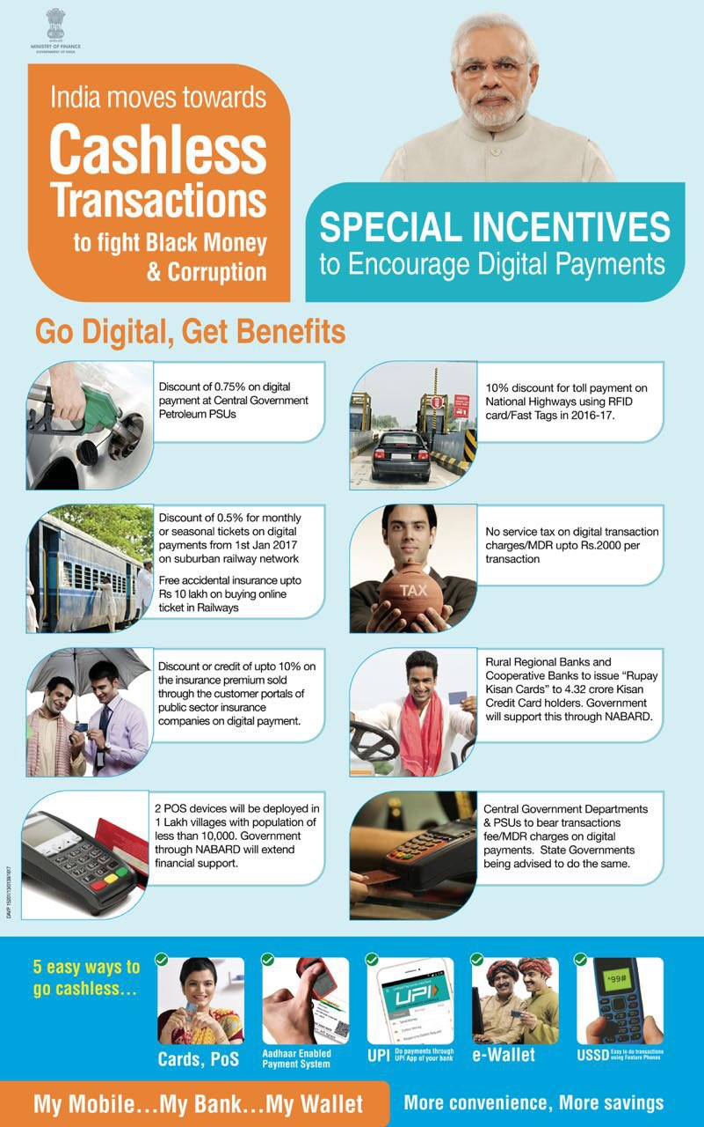
Lucky Grahak Yojana
&
Digi-धन Vyapar Yojana

Slide 6
Promoting
& Rewarding Digital Payments
Coverage
Digital Transactions through RuPay Cards, UPI, AEPS & USSD
Awards
Implementing Agency
National Payment Corporation of India (NPCI)
Transactions between ₹50- ₹3,000
Random draw of Digital Transaction Ids to select awardees
Separate incentives for Consumers and Merchants

Slide 7
Mega Awards
(14.04.17)
Consumers
Transactions Beginning (08.11.16)
Daily : 15000 @ ₹1000 for 100 days
Weekly : 7000+ with max prize of 1 lakh
Lucky Grahak Yojana
for consumers
₹ 1 Crore
₹50 Lakh
₹25 Lakh
First Draw
Digi-धन Vyapar Yojana
for merchants
(25.12.16)
₹50 Lakh
₹25 Lakh
₹5 Lakh
Weekly Awards :7000 with max award of ₹50,000
Merchants

Slide 8
Promoting
& Rewarding Digital Payments
Estimated Expenditure
Rules
What is not covered
Transactions above Rs 3000/- and below 50/-
C2M, C2G and all AEPS transactions
Technical and Security Audit of the backend software/ infra by NPCI
Transactions using RuPay, USSD, UPI & AEPS only
P2P and B2B transfers
Transactions through Credit cards/ e wallets
₹ 340 Crore

